Slide 1


Slide 2

Mini Project (01CE0609)
Review 1 (08/03/2025)
Multimodal Mental Health Using Machine Learning Team ID: 6CE_158
Team Member 1: Neeharika Joshi (92200103099) (6-TC2)
Team Member 2: Saurav Patra (92200103101) (6-TC2)
Team Member 3: Shubham Pandit (92200103155) (6-TC2)
Guided By
Internal Guide Name: Prof. Ravikumar Natarajan
Department of Computer Engineering,
Faculty of Engineering & Technology

Slide 3
Outline
Introduction
Abstract
Literature Review
System Design (Workflow)
Methodology
1) Data Collection
2) Data Preprocessing and Visualization
3) Model Selection
4) Result Analysis
Project Scheduling (Gantt Chart)
Tools and Technologies
Future Works
Conclusion
References

Slide 4


Introduction
Mental health disorders are a growing concern worldwide, yet traditional diagnostic methods rely on self-reports and clinical assessments, which can be subjective and limited. To address this, we are developing a multimodal mental health detection model that integrates textual, visual, and acoustic data for a more accurate and comprehensive analysis. The model will analyze text from user inputs, visual data from facial expressions, and acoustic data from speech patterns to detect signs of mental distress. This will be implemented in a Web application that identifies potential mental health concerns. By leveraging AI-driven multimodal analysis, this system aims to improve early mental health detection and provide accessible, real-time support for users.

Slide 5
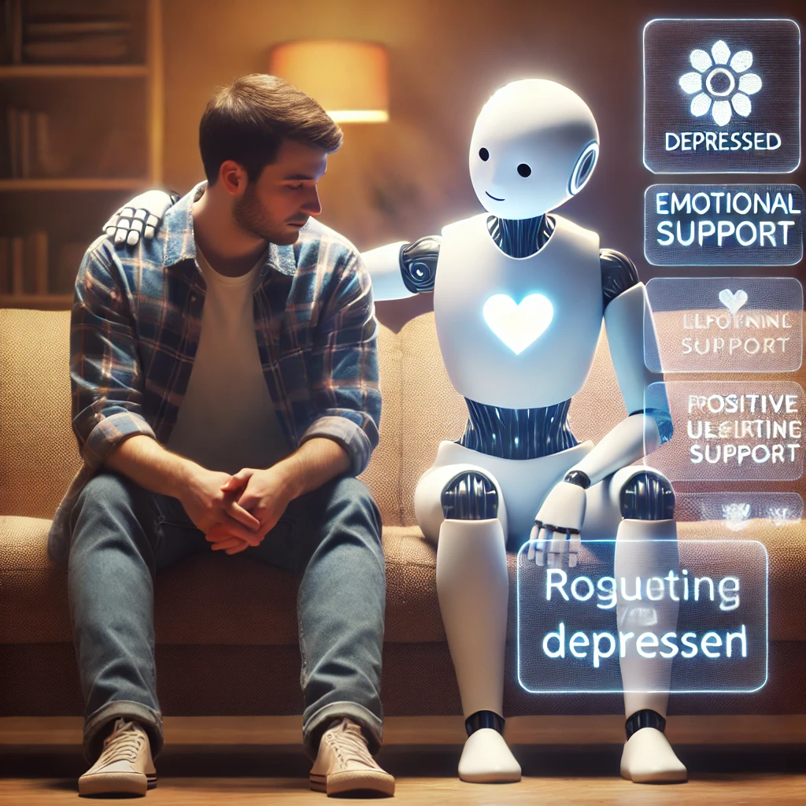
Abstract
This project focuses on developing a multimodal mental health detection system that integrates textual, visual, and acoustic data to assess an individual's mental well-being. For textual analysis, we are using two different datasets: one emotion-based dataset and another specifically for mental health disorders. After evaluating multiple models, we found that BERT provides the highest accuracy for detecting mental health patterns for textual data. For acoustic analysis, we are using CNN-LSTM to examine speech features such as tone, pitch, and rhythm, which are strong indicators of emotional and psychological states. Additionally, YOLOv8n modal is used to analyze facial expressions and micro-expressions for detecting emotional cues. This multimodal system will be implemented in a web application, allowing users to receive real-time mental health assessments. The goal of this project is to provide an AI-driven, user-friendly, and accessible tool for mental health detection and early intervention.

Slide 6
Literature Review
Ref No. | Date | Paper Name | Dataset | Results | Methodology | Limitation
[1] | 2025 | Multimodal Data Fusion Techniques for Accurate Elderly Mental State Evaluation | InsPLAD, Contextual Object Detection, Children Speech Recognition Challenge, LibriSpeech, EarthVQA, ERIT. | Accuracy - 90.0% (+3.5%), Precision - 88.5%, Recall - 91.2%, F1 - 89.8%, AUC - 0.935. | Integrated video, audio, and physiological data; uses BERT & CNNs; evaluated with cross-validation on 10K+ multimodal inputs. | Challenges include synchronization issues, data quality dependency, high computational demands, and limited model robustness.
[2] | 2022 | Real-time mental stress detection using multimodality expressions with a deep learning framework | Used facial expressions, ECG, and voice during the Montreal Imaging Stress Task (MIST). | Accuracy - 85.1% | A real-time deep learning framework using ECG, voice, and facial expressions for stress detection, preprocessing time-frequency changes, extracting multidimensional features, and fusing them into a global matrix. ResNet50 and I3D with a temporal attention module enhanced feature extraction, validated on the MIST dataset. | EEG, EMG, and fNIRS require special equipment limiting practicality. Single-modality detection underutilizes data. Existing studies often overlook multimodal integration benefits.
Notes:
Not enough data
Need special equipment like EEG
Too heavy on computers – making them hard to use in real life
Messy data handling
Not useful for everyone(like English speaker)

Slide 7
Literature Review
Ref No. | Date | Paper Name | Dataset | Results | Methodology | Limitation
[3] | 2024 | Multimodal Sensing for Depression Risk Detection: Integrating Audio, Video, and Text Data | The study utilized data from 1911 subjects, including 767 males and 1144 females, collected at Shenzhen Kangning Hospital | F1 Score - 0.78, Precision - 0.76, Recall - 0.81 | The study employs LBP for facial feature extraction and uses ML models like SVR, SVM, RF, DT, and LR. The AVTF-TBN model integrates audio, video, and text through a three-branch architecture, utilizing an emotion elicitation paradigm for data collection. | The limitations include shallow interview questions in the DAIC-WOZ dataset, small public depression risk detection datasets, lack of original videos for raw data feature extraction, reliance on self-assessment scales that may obscure true mental states, and an imbalance in doctor-patient ratios affecting detection efficiency and reliability.
[4] | 2024 | A Reinforcement Learning-Based Approach for Promoting Mental Health Using Multimodal Emotion Recognition | FER2013, RAV-DESS, SAVEE, TESS-Toronto, CREMA-D, Sri Lanka-specific dataset, Emotions, Emotion-stimulus dataset. | Accuracy: 72% (facial expressions), 73% (vocal tones), 86% (text). | A culturally specific multimodal emotion prediction system using facial expressions, vocal tones, and text. An RL agent provides tailored CBT recommendations. SER methods (SMO, MLP, Logistic Regression) and CNN-based approaches improve accuracy, refined by a weighted algorithm. | Focus on Sri Lankan youth and English speakers limits generalizability. Data variability and short duration affect long-term insights. Emotion models need refinement, larger samples, and vocal tone integration for better accuracy..

Slide 8
Literature Review
Ref No. | Date | Paper Name | Dataset | Results | Methodology | Limitation
[5] | 2024 | Multimodal Affective Communication Analysis: Fusing Speech Emotion and Text Sentiment Using Machine Learning | EmoUERJ, ESD. | DBMM: SER - 96% (EmoUERJ), 98% (ESD) DBMM: Sentiment Analysis - 85% (EmoUERJ), 95% (ESD) | The study combines SER and SA for enhanced emotional understanding, utilizing ML models like GNB, SVM, RF, MLP, and 1D-CNN. It introduces DBMM and 2L-DBMM for improved emotion and sentiment fusion. | Focus on Sri Lankan youth and English speakers limits generalizability. Data variability and short duration affect long-term insights. Emotion models need refinement, larger samples, and vocal tone integration for better accuracy..
[6] | 2025 | Multimodal Data Fusion for Depression Detection Approach | DAIC-WOZ, EDAIC-WOZ | Accuracy - 86%, AUC Score - 0.73 | The study used early and late fusion networks with CNN, Bi-LSTM, and self-attention for multimodal depression detection. | The study faces limitations in transcript accuracy, lack of speaker separation, complex preprocessing for early fusion, and low accuracy in some reviewed models.

Slide 9
Literature Review
Ref No. | Date | Paper Name | Dataset | Results | Methodology | Limitation
[7] | 2024 | FPT-Former: A Flexible Parallel Transformer of Recognizing Depression by Using Audiovisual Expert-Knowledge-Based Multimodal Measures | Extended Distress Analysis Interview Corpus (E-DAIC) | RMSE - 4.80, MAE - 4.58, Depression Classification Accuracy (PHQ-8 ≥ 10) - 0.79 | The study employs the FPT model for multimodal depression analysis using the E-DAIC dataset, integrating visual, audio, and textual features extracted via OpenFace 2.1.0 and OpenSMILE, with expert-knowledge-based descriptors as inputs, and evaluated using 10-fold cross-validation, demonstrating the effectiveness of three-modality fusion over single- and two-modality approaches. | The FPT-Former model has limitations in comprehensiveness and accuracy for depression severity estimation, requiring future improvements for enhanced predictive capability.
[8] | 2024 | A Multimodal Fusion Network for Student Emotion Recognition Based on Transformer and Tensor | The study used WeChat messaging transcripts, including text and emoticon images, with 262 annotated messages from 191 users. | Accuracy - 93.65%, AUC Score - 96.58% | The study uses a multi-modal model based on the Transformer architecture and tensor product fusion, combining BERT for text and ViT for images, with early, late, and intermediate fusion techniques. | The study's limitations include CLIP's poor generalization, ViLBERT's slow inference, the proposed model's high resource consumption, and a limited analysis of only two modalities.

Slide 10
Workflow
User Opens the App
User Logs in / Signs Up
Data Collection from User
(Text, Audio, Video Input)
(BERT, CNN, Acoustic)
Multimodal Fusion for Final Prediction
Model Inference
Preprocessing & Feature Extraction
Mental Health Status Classification
Interactive UI display’s the prediction

Slide 11






Methodology
01. Research work on the given Project
02. Data Collection and Visualization
03. Data Preprocessing and Visualization
04. Tried Various Models / Algorithms
05. Model Training with Suitable Algorithm
06. Predictions and Integration

Slide 12
1.Data Collection
Textual Data
Acoustic Data
Visual Data
Mental Health Disorder Data
Emotion Classification Data
Emotion Classification Data
Emotion Classification Data
(1,07,850 records)
(4,22,747 records)
(6,789 records)
(9,350 records)
Anxiety
Fear
Angry
Angry
Bipolar
Love
Disgusted
Disgusted
Depression
Angry
Surprise
Fear
Normal
Sad
Happy
Happy
Stress
Joy
Neutral
Suicidal
Surprised
Sad

Slide 13
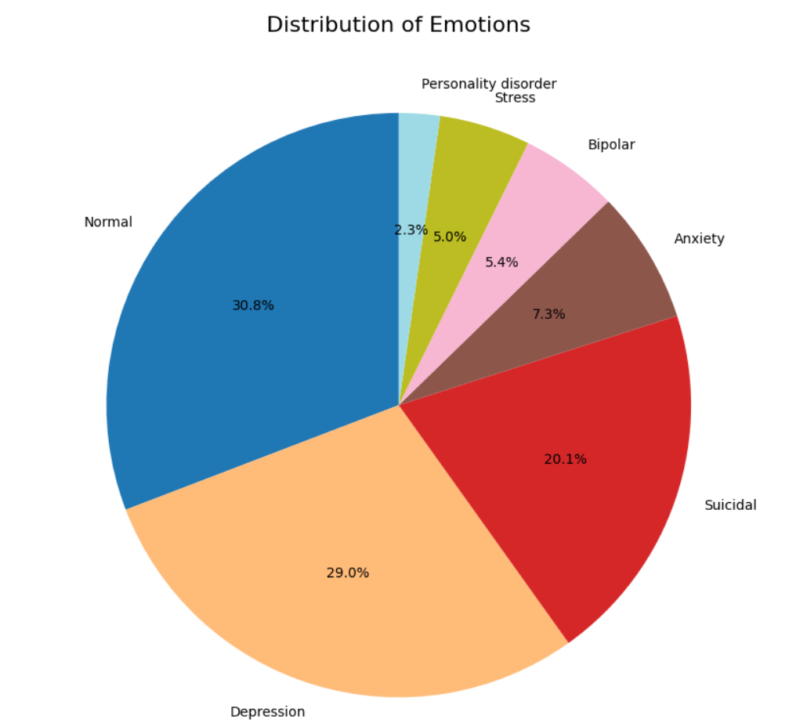
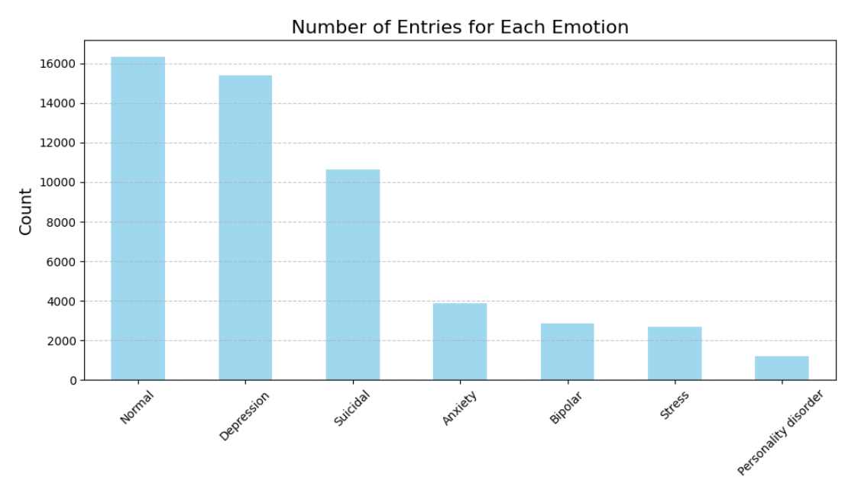
2.Data Visualization (Before Preprocessing)
Textual data :
Mental Disorder Dataset

Slide 14
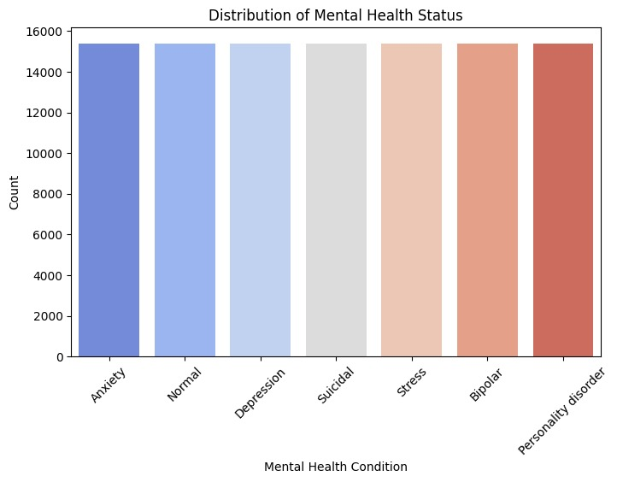
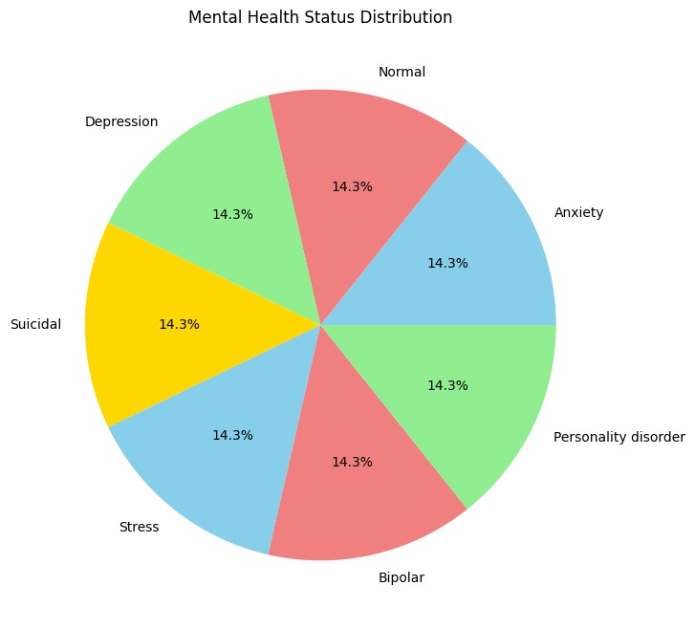
2.Data Visualization (After Preprocessing)
Textual data :
Mental Disorder Dataset

Slide 15
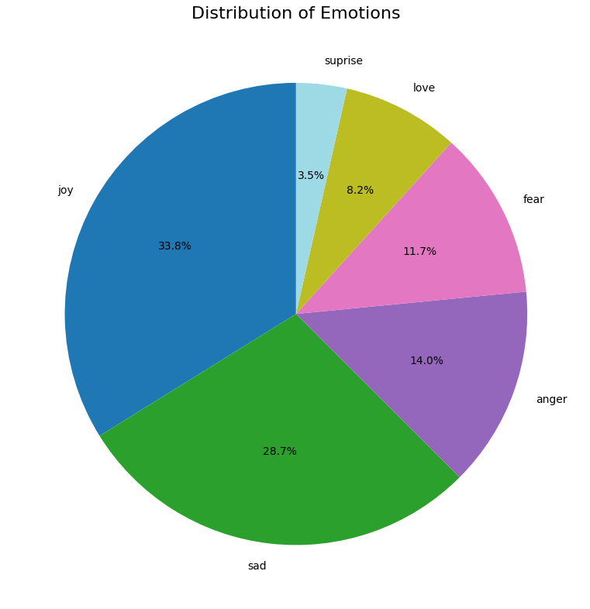
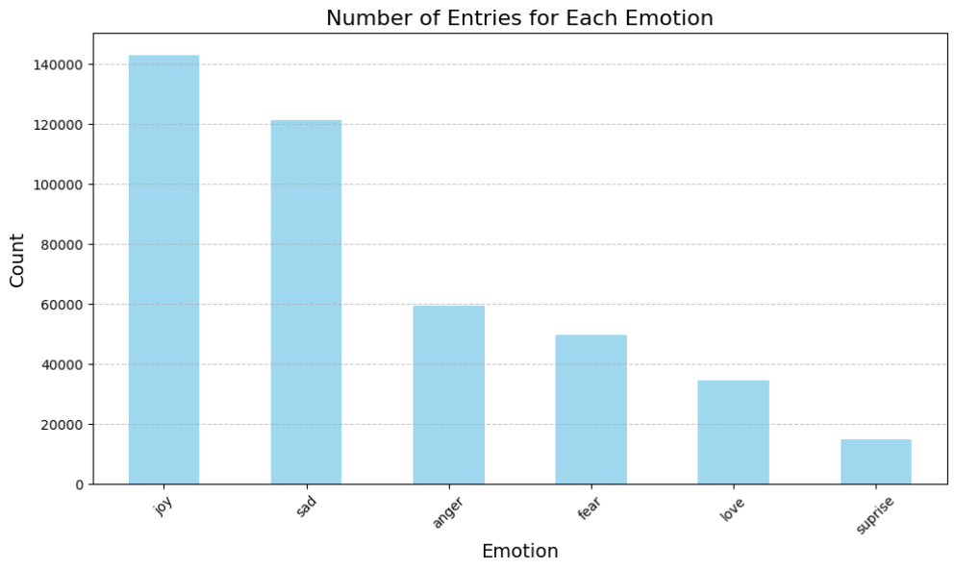
2.Data Visualization
Textual data : (for emotion-based textual data , data is cleaned and giving good accuracy for test and train both so there is not need for preprocessing)
Emotion Detection Dataset

Slide 16
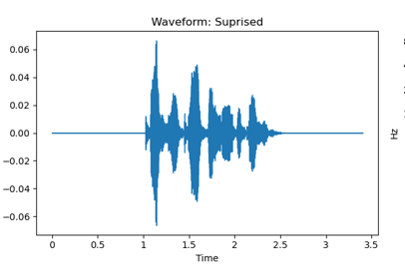
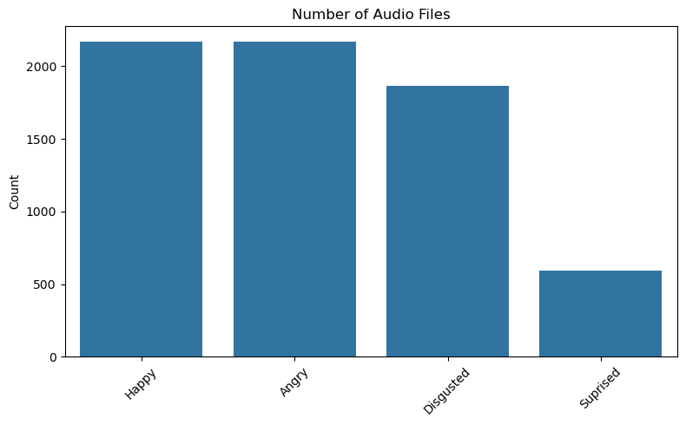
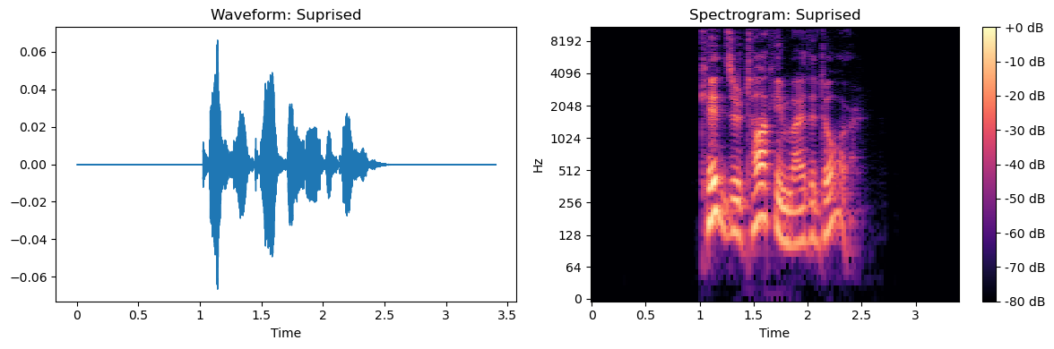
3.Data Visualization
Acoustic data : (for emotion-based Audio data , data is cleaned so there is not need for preprocessing)
Emotion Based Dataset
e.g. Visualization for Surprise emotion

Slide 17
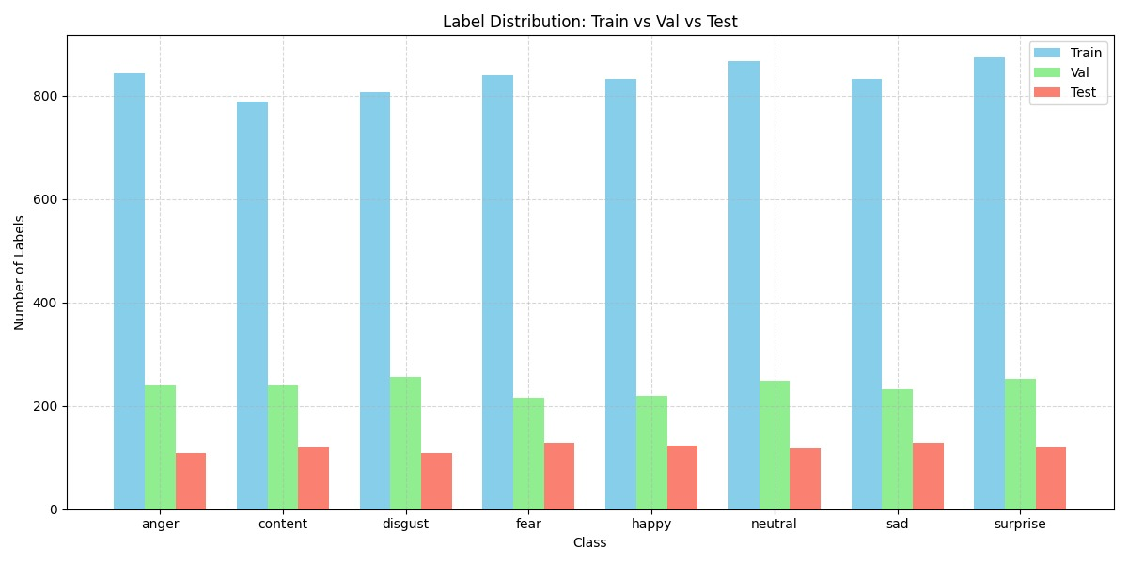
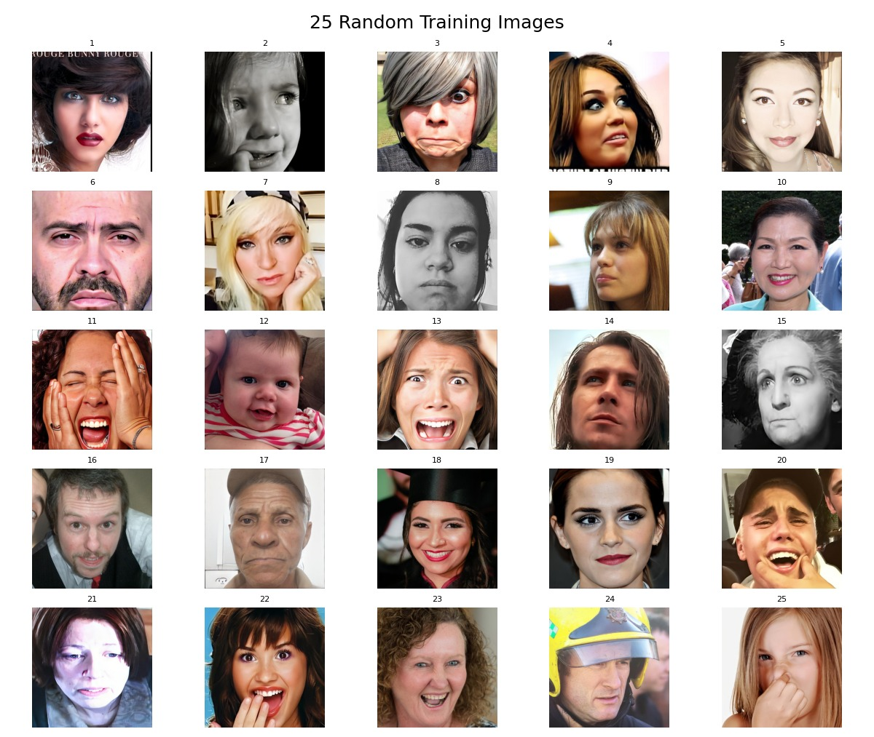
2.Data Visualization
Visual data : (Ongoing)
Emotion Based Dataset

Slide 18
3.Model Selection
LSTM:
1. LSTM effectively remembers significant information from previous components of a sentence to facilitate understanding of the mental illness and emotion-based text context.
2. In contrast to standard RNNs, LSTM avoids the vanishing gradient issue with gating mechanisms to provide improved accuracy in text classification.
LSTM with RNN:
1. LSTMs can retain important context over long text sequences, crucial for mental illness and emotion detection.
2. RNNs process text in order, making them ideal for understanding patterns in language and emotions.
BiLSTM:
1. BiLSTM learns past and future context, improving text understanding.
2. Enhances detection of emotions and mental health patterns in text.
BERT:
1. BERT captures word meanings bidirectionally, which is essential for understanding nuanced emotions and mental health expressions.
2. It leverages vast pre-trained linguistic knowledge, improving accuracy in detecting emotions and mental illness patterns with limited labeled data.

Slide 19
3.Model Selection
CNN with BiLSTM (for acoustic data):
1. CNN extracts spatial features from audio representations (e.g., spectrograms), capturing local patterns crucial for emotion recognition.
2. Bi-LSTM captures temporal dependencies by processing speech data in both forward and backward directions, improving context understanding for better emotion classification.
CNN Transformer (for acoustic data):
1. CNNs efficiently extract local and temporal features from spectrograms, capturing crucial pitch and frequency patterns in speech.
2. Transformers handle long-range dependencies, capturing tone variations over time for better emotion classification.
CNN-LSTM (for acoustic data):
1. CNN extracts key audio features like pitch and tone from spectrograms.
2. LSTM captures time-based patterns, helping understand emotional flow in speech.
YOLOv8n (for Visual data):
1. Fast and Lightweight: YOLOv8n is optimized for real-time detection with minimal computational resources, perfect for web applications.
2.Accurate Emotion Detection: It effectively captures subtle facial expressions and micro-expressions crucial for mental health analysis.

Slide 20
4. Result Analysis (Textual Data)
Mental Disorder Dataset:
Model Name | Accuracy | Precision | Recall | F1_Score
LSTM | 87% | 87.16% | 87.22% | 87.13%
LSTM - RNN | 16% | 6.83% | 15.92% | 9.46%
BiLSTM | 90% | 89.33% | 89.54% | 89.38%
BERT | 92% | 92% | 92% | 92%
Thus, we selected BERT model , as it is giving high accuracy comparatively as of far.
Emotion Detection Dataset:
Model Name | Accuracy | Precision | Recall | F1_Score
LSTM | 33.98% | 11.58% | 34.04% | 17.28%
LSTM - RNN | 33.84% | 11.45% | 33.83% | 17.11%
BiLSTM | 90% | 89.33% | 89.54% | 89.38%
BERT | 93.6% | 94.0% | 93.6% | 93.6%
Thus, we selected BERT model , as it is giving high accuracy comparatively as of far.
Notes:
Accuracy = How many predictions were correct overall?
Precision = Out of the True Positive predictions, how many were actually correct?
Recall = Out of all real True Positive cases, how many did we catch?
F1-Score = A balance between Precision and Recall.

Slide 21
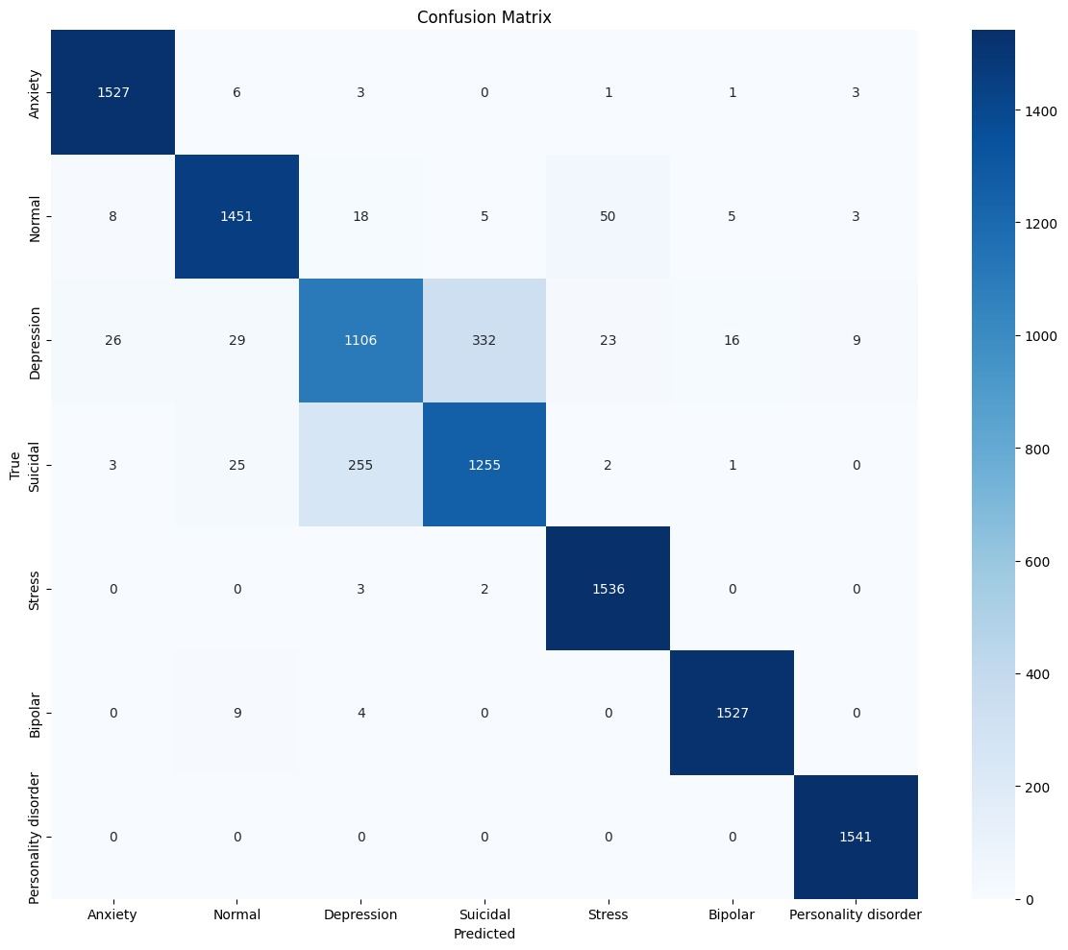
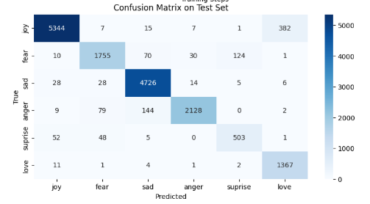
4. Result Analysis (Textual Data)
Mental Disorder Dataset Graphical Representation of BERT model:
Emotion Detection Dataset Graphical Representation of BERT model:

Slide 22
4. Result Analysis (Acoustic Data)
Emotion Detection Dataset:
Model Name | Accuracy | Precision | Recall | F1_Score
CNN | 41% | 59% | 41% | 37%
CNN - BiLSTM | 39.31% | 39.17% | 39.32% | 38.85%
CNN -Transformer | 60.64% | 60.73% | 60.72% | 59.09%
CNN-RNN | 63% | 64% | 63% | 63%
CNN-LSTM | 85% | 85% | 85% | 85%
Thus, we selected CNN-LSTM model , as it is giving high accuracy comparatively as of far.
Notes:
Top Graph (Loss):
Lower is better!
gradually decreasing, which is good.
validation loss (dashed lines) is bouncing up and down, meaning the models struggle with new (unseen) data.
Bottom Graph (Accuracy):
Higher is better!
Training accuracy (solid lines) keeps going up, which is great.
Validation accuracy (dashed lines) is unstable, meaning the models might be memorizing training data instead of actually learning patterns (overfitting)

Slide 23
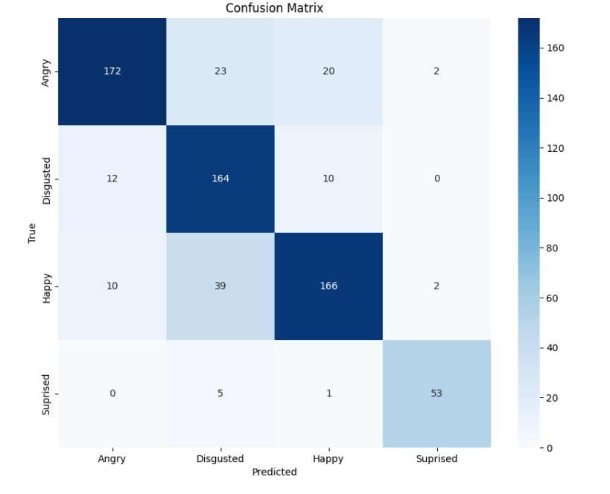
4. Result Analysis (Acoustic Data)
Confusion Matrix of CNN-LSTM
Notes:
Top Graph (Loss):
Lower is better!
gradually decreasing, which is good.
validation loss (dashed lines) is bouncing up and down, meaning the models struggle with new (unseen) data.
Bottom Graph (Accuracy):
Higher is better!
Training accuracy (solid lines) keeps going up, which is great.
Validation accuracy (dashed lines) is unstable, meaning the models might be memorizing training data instead of actually learning patterns (overfitting)

Slide 24
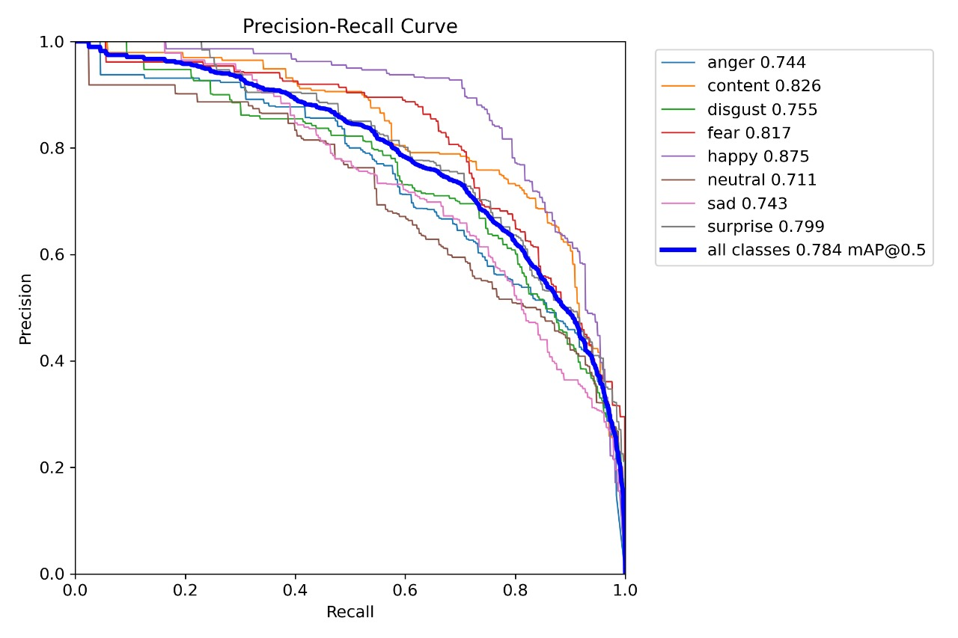
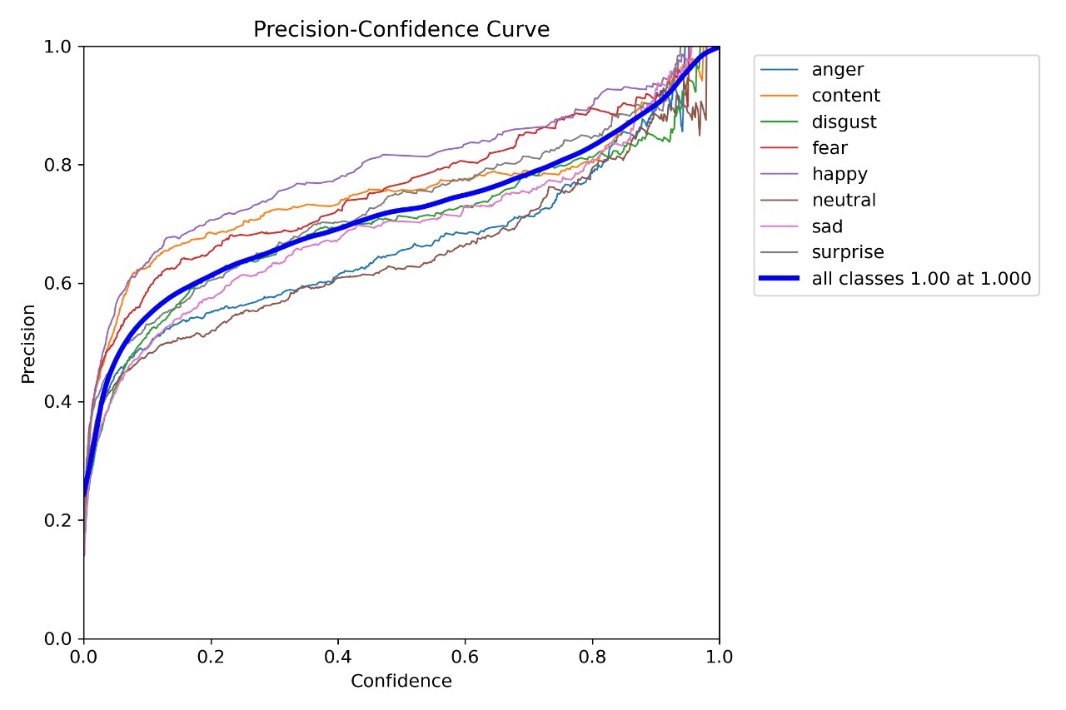
4. Result Analysis (Visual Data)
Emotion Detection Dataset:
Model Name | Precision | Recall | F1_Score
YOLOv8l | 67% | 75.35% | 70.95%
YOLOv8m | 69% | 73.11% | 71.18%
YOLOv8n | 70% | 73.72% | 72.08%
Thus, we selected YOLOv8n model , as it is giving high accuracy comparatively as of far.
Notes:
Top Graph (Loss):
Lower is better!
gradually decreasing, which is good.
validation loss (dashed lines) is bouncing up and down, meaning the models struggle with new (unseen) data.
Bottom Graph (Accuracy):
Higher is better!
Training accuracy (solid lines) keeps going up, which is great.
Validation accuracy (dashed lines) is unstable, meaning the models might be memorizing training data instead of actually learning patterns (overfitting)

Slide 25
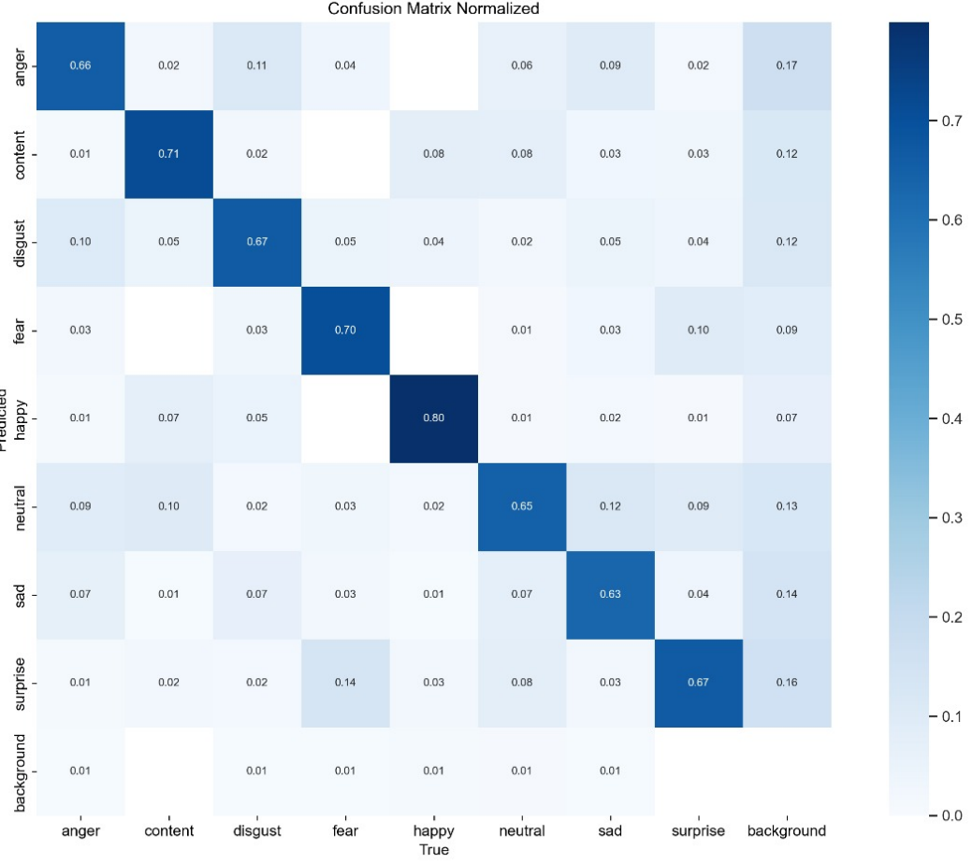
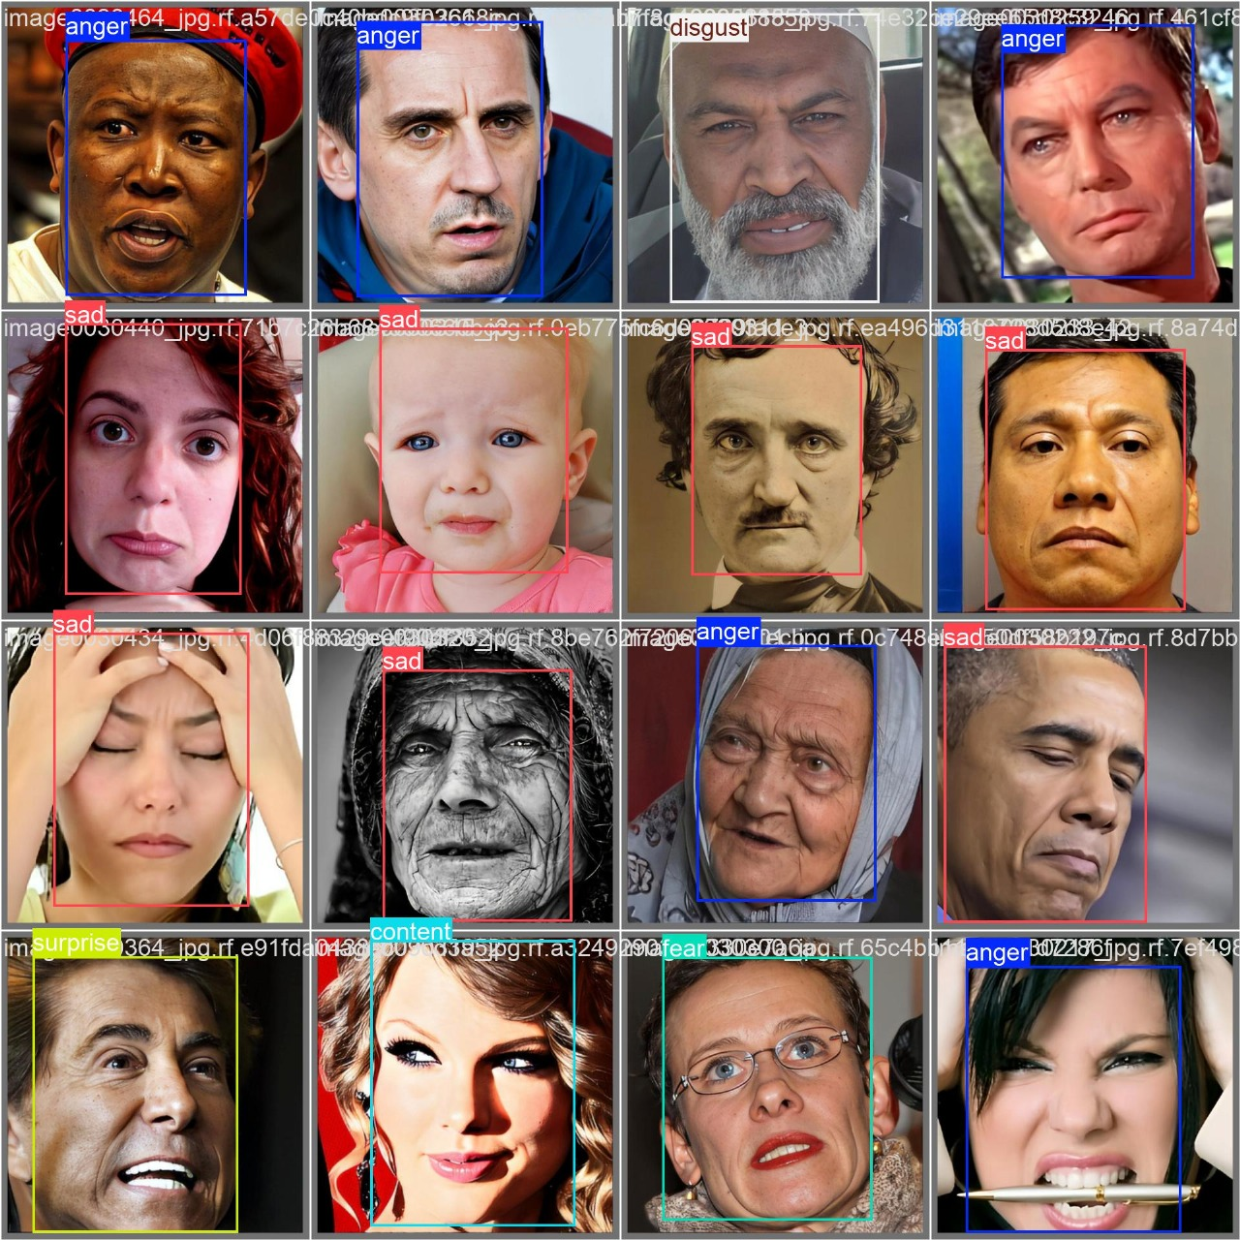
4. Result Analysis (Visual Data)
Confusion Matrix of CNN-LSTM
Notes:
Top Graph (Loss):
Lower is better!
gradually decreasing, which is good.
validation loss (dashed lines) is bouncing up and down, meaning the models struggle with new (unseen) data.
Bottom Graph (Accuracy):
Higher is better!
Training accuracy (solid lines) keeps going up, which is great.
Validation accuracy (dashed lines) is unstable, meaning the models might be memorizing training data instead of actually learning patterns (overfitting)

Slide 26
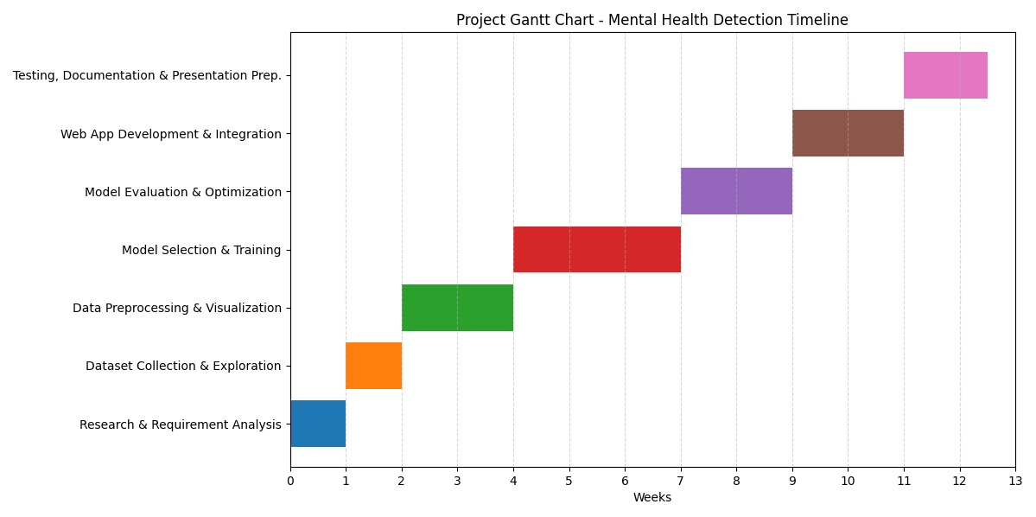
Project Scheduling (Gantt Chart)

Slide 27




Tools and Technologies
Development Tools and Platforms
Python – Core language for model development and preprocessing
VS Code – Primary code editor
Jupyter Notebook – For step-by-step model training and visualization
Kaggle – Dataset sourcing, exploration, and experimentation
Machine Learning & Deep Learning Frameworks
TensorFlow
Keras
PyTorch
OpenCV – For real-time facial expression detection
FastAPI – Backend API integration and deployment
Frontend Technologies
React.js – For building the responsive and interactive web UI
Tailwind CSS – For styling and responsive design
Models and Algorithms
BERT – For textual emotion and mental health analysis
CNN-LSTM – For acoustic analysis of tone, pitch, and rhythm
YOLOv8n – For real-time visual emotion recognition through facial expression detection

Slide 28

Future Work
Future improvements aim to significantly enhance the system’s accuracy, adaptability, and accessibility. For textual analysis, integrating sentiment-aware attention mechanisms and fine-tuning BERT with more diverse, emotionally rich datasets will help the system better understand subtle expressions such as sarcasm, irony, and metaphor. This will enable more accurate detection of emotional states across varied communication styles. In the acoustic module, applying speaker normalization techniques and incorporating larger, more diverse voice datasets will improve generalization across different users, reducing bias caused by variations in tone, pitch, and speaking style. The use of real-time adaptive algorithms will further boost performance during live interactions. To broaden usability, the system will be expanded to support multiple languages, allowing users from different linguistic backgrounds to benefit from its capabilities. Additionally, the inclusion of user personalization features—such as emotion history tracking and tailored feedback, will make the platform more engaging and relevant to individual needs. Finally, developing a lightweight mobile version with offline capabilities will ensure the tool is more accessible, especially in regions with limited internet connectivity, thus supporting broader outreach and real-world applicability.

Slide 29
Conclusion
This project successfully developed a web-based multimodal mental health detection system that analyzes text, audio, and visual data using machine learning models like BERT, CNN-LSTM, and YOLOv8n. The integration of these models enables accurate and real-time assessment of a user’s emotional and mental state.
Built using React and FastAPI, the system offers a user-friendly interface and provides immediate feedback along with chatbot-based emotional support. The use of open-source tools and publicly available datasets made the solution cost-effective and feasible within the academic timeline.
Overall, the project meets its objectives and presents a scalable, AI-driven approach to mental health detection, promoting early intervention and greater accessibility.

Slide 30
References
[1] Zhang, X., Zhao, L., Sun, H., Li, Y., Chen, W., & Wang, J. “Multimodal-Data-Fusion-Techniques-for-Accurate-Elderly-Mental-State-Evaluation” , 2025.
[2] Jing Zhang1 , Hang Yin1 , Jiayu Zhang1 , Gang Yang1 , Jing Qin2 and Ling He1*, “Real-time mental stress detection using multimodality expressions with a deep learning framework ” 2022.
[3] D. R. Faria, "Multimodal affective communication analysis: Fusing speech emotion and text sentiment using machine learning," Applied Sciences, vol. 14, no. 15, p. 6631, 2024.
[4] Y. Li, X. Yang, M. Zhao, Z. Wang, Y. Yao, W. Qian, and S. Qi, "FPT‐Former: A Flexible Parallel Transformer of Recognizing Depression by Using Audiovisual Expert‐Knowledge‐Based Multimodal Measures," International Journal of Intelligent Systems, vol. 2024, no. 1, p. 1564574, 2024.
[5] M. Nykoniuk, O. Basystiuk, N. Shakhovska, and N. Melnykova, "Multimodal Data Fusion for Depression Detection Approach," Computation, vol. 13, no. 1, p. 9, 2025.
[6] A. Pathirana, D. K. Rajakaruna, D. Kasthurirathna, A. Atukorale, R. Aththidiye, and M. Yatipansalawa, "A Reinforcement Learning-Based Approach for Promoting Mental Health Using Multimodal Emotion Recognition," Journal of Future Artificial Intelligence and Technologies, vol. 1, no. 2, pp. 124-142, 2024.

Slide 31
References
[7] A. Xiang, Z. Qi, H. Wang, Q. Yang, and D. Ma, "A multimodal fusion network for student emotion recognition based on transformer and tensor product," in 2024 IEEE 2nd International Conference on Sensors, Electronics and Computer Engineering (ICSECE), pp. 1-4, 2024.
[8] Z. Zhang, S. Zhang, D. Ni, Z. Wei, K. Yang, S. Jin, G. Huang, Z. Liang, L. Zhang, L. Li, and H. Ding, "Multimodal sensing for depression risk detection: Integrating audio, video, and text data," Sensors, vol. 24, no. 12, p. 3714, 2024.

Slide 32


